Slide 1
UNIT-II: SATELLITE SUBSYSTEMS
Notes:
1
1

Slide 2
UNIT-II: SATELLITE SUBSYSTEMS
1. Attitude and orbit control system (AOCS)
2. Telemetry tracking, Command and monitoring
3. Power systems
4. Communication subsystems
5. Satellite antennas
6. Equipment reliability and Space qualification
Notes:
3
3

Slide 3
Introduction to Satellite subsystems
The major subsystems required on the satellite are given below.
Attitude and Orbit Control System (AOCS).
b) Telemetry, Tracking, Command, and Monitoring (TTC&M).
Power System
Communication Subsystems
e) Satellite Antennas

Slide 4
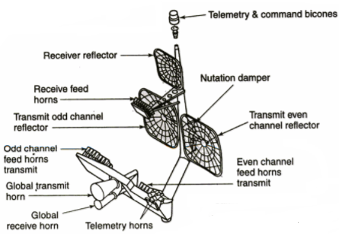
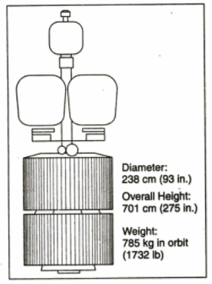
Fig 3.1 shows an exploded view of a typical geostationary (GEO) satellite with several of the subsystems indicated.
Fig 3.1

Slide 5
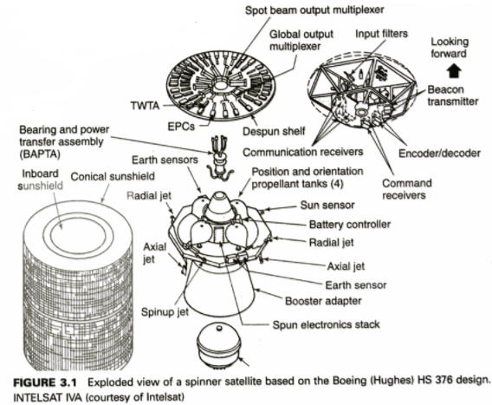

Slide 6
Attitude and Orbit Control System (AOCS).
This subsystem consists of rocket motors that are used to move the satellite back to the correct orbit when external forces cause it to drift off station and gas jets or inertial devices that control the attitude of the satellite.

Slide 7
Telemetry, Tracking, Command, and Monitoring (TTC&M).
These systems are partly on the satellite and partly at the controlling earth station.
The telemetry system sends data derived from many sensors on the satellite, which monitor the satellite’s health, via a telemetry link to the controlling earth station.
The tracking system is located at this earth station and provides information on the range and the elevation and azimuth angles of the satellite.
Repeated measurement of these three parameters permits computation of orbital elements, from which changes in the orbit of the satellite can be detected.
Based on telemetry data received from the satellite and orbital data obtained from the tracking system, the control system is used to correct the position and attitude of the satellite.
It also used to control the antenna pointing and communication system configuration to suit current traffic requirements, and to operate switches on the satellite.

Slide 8
Power system
All communications satellites derive their electrical power from solar cells.
The power is used by the communications system, mainly in its transmitters, and also by all other electrical systems on the satellite.
The latter use is termed housekeeping, since these subsystems serve to support the communications system.

Slide 9
Communications Subsystems
The communications subsystem is the major component of a communications satellite, and the remainder of the satellite is there solely to support it.
Frequently, the communications equipment is only a small part of the weight and volume of the whole satellite.
It is usually composed of one or more antennas, which receive and transmit over wide bandwidths at microwave frequencies, and a set of receivers and transmitters that amplify and retransmit the incoming signals.
The receiver-Transmitter units are known as Transponders.

Slide 10
Communications Subsystems…. cont
There are two types of transponder in use on satellites:
The linear or bent pipe transponder that amplifies the received signal and retransmits it at a different, usually lower frequency and
The baseband processing transponder which is used only with digital signals, that converts the received signal to baseband, processes it, and then retransmits a digital signal.

Slide 11
Satellite Antennas
Although these form part of the complete communication system, they can be considered separately from the transponders.
On large GEO satellites the antenna systems are very complex and produce beams with shapes carefully tailored to match the areas on the earth’s surface served by the satellite.
Most satellite antennas are designed to operate in a single frequency band, for example, C band(4 to 8GHz) or Ku(12-18GHz) band.
A satellite which uses multiple frequency bands usually has four or more antennas.
The operation of Satellite -The thermal control system that regulates the temperature inside a satellite, for example.

Slide 12
Attitude and Orbit Control System (AOCS)
AOCS is needed to get the satellite into the correct orbit and keep it there
Orbit insertion
Orbit maintenance
Fine pointing
Major parts
Attitude Control System
Orbit Control System

Slide 13
ORBIT INSERTION - GEO
TWO BASIC TYPES OF GEO INSERTION:
High-Energy Apogee Kick Motor firing
. A few minutes, symmetrical about apogee
Low-Energy AOCS burn
.Tens of minutes to > one hour burns, symmetrical about apogee
.Uses Dual-Mode thrusters; i.e. thrusters used for

Slide 14
ORBIT MAINTENANCE - 1
Must Control Location In GEO &Position Within Constellation
Satellites Need In-plane (E-W) & Out-of-plane (N-S) Maneuvers To Maintain The correct Orbit
Leo Systems Less Affected By Sun and moon But may need more Orbit-phasing control

Slide 15
ORBIT MAINTENANCE - 2
GEO STATION-KEEPING BURNS ABOUT EVERY 4 WEEKS FOR +-0.05
DO N-S AND E-W ALTERNATELY
N-S REQUIRES ^10x E-W ENERGY
RECENT APPROACH USES DIFFERENT THRUSTERS FOR E-W AND N-S

Slide 16
FINE POINTING
SATELLITE MUST BE STABILIZED TO PREVENT NUTATION (WOBBLE)
THERE ARE TWO PRINCIPAL FORMS OF ATTITUDE STABILIZATION
BODY STABILIZED (SPINNERS, SUCH AS INTELSAT VI)
THREE-AXIS STABILIZED (SUCH AS THE ACTS,GPS, ETC.)

Slide 17
DEFINITION OF AXES - 1
ROLL AXIS
Rotates around the axis tangent to the orbital plane
( N-S on the earth)
PITCH AXIS
Moves around the axis perpendicular to the orbital
plane (E-W on the earth)
YAW AXIS
Moves around the axis of the subsatellite point

Slide 18
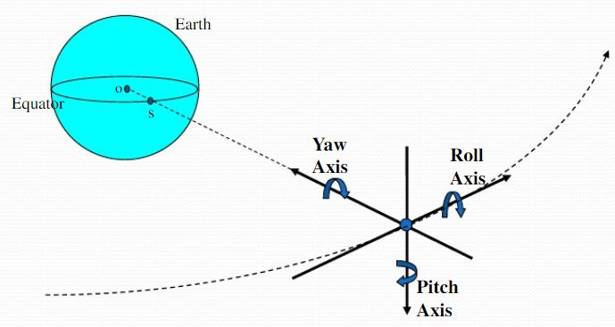
DEFINITION OF AXES

Slide 19
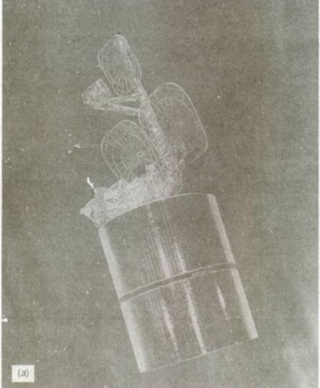
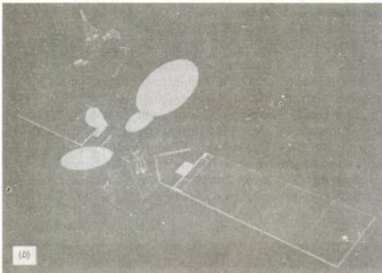
Figure 3.3 (a) A Spinner satellite, INTELSAT IV A (b) A three-axis stabilized satellite, INTELSAT V

Slide 20
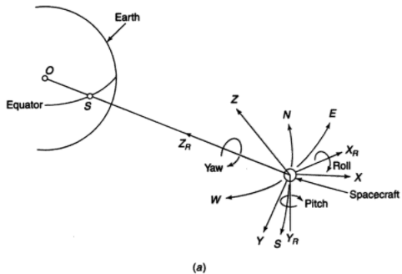
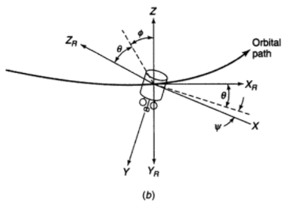

Slide 21
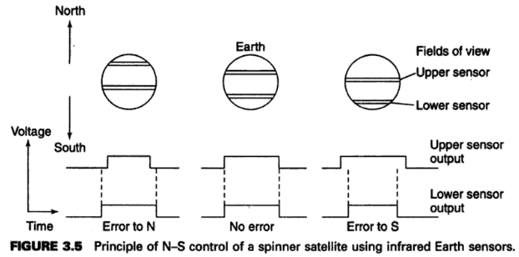


Slide 22
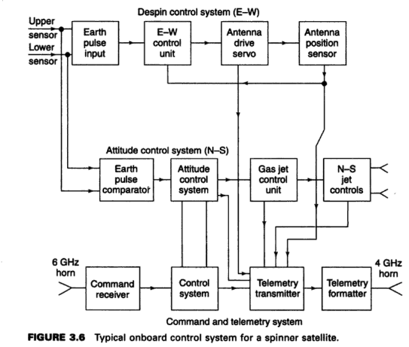

Slide 23
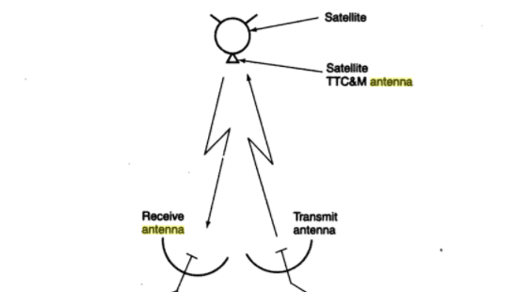
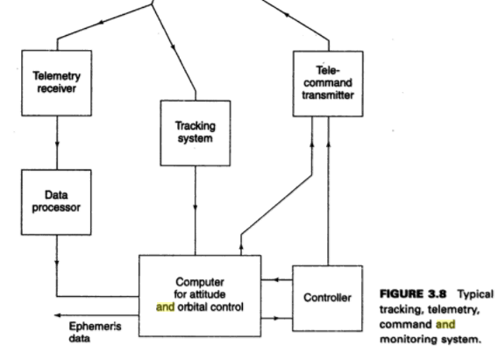
TTC& M

Slide 24
Telemetry System:
TTC&M subsystems are located partly on satellite and partly on earth station.
The telemetry link sends the data about satellite’s health to the earth station.
At the ground station the tracking system provides the information about the range, azimuth and elevation angles of the satellite.
By repeated measurement of these data, the changes in the orbit can be optimized.
The telemetry data from satellite and orbital data from earth station are used to correct the position and attitude of the satellite and also to control the antenna pointing and communication system configuration.
Large no. of sensors located within the satellite sends data to the controlled computer at the earth station used to monitor, store and decode the telemetry data.
The sensors usually monitor pressure in the fuel tanks, voltage and current in the power conditioning unit, current drawn by each subsystem, critical voltages and currents in the communication circuits, temperature rise in different subsystems.
Telemetry system used during the launching and also when the satellite in GEO orbit, a highly directive antenna and PSK modulated and TDM multiplex digital data are sent to the earth station.
Low data rate used such that the receiver bandwidth is a narrow bandwidth and high carrier to noise ration.

Slide 25
Tracking System:
Tracking system in the TTC&M subsystem is used to determine the satellite’s orbit during launching and then to track the satellite. It determines the current orbit of a satellite.
Various techniques for tracking of a satellite.
Velocity and acceleration sensors on the satellites can be used to establish the change in orbit. Doppler shift of the telemetry carrier from the earth station or beacon transmitter may be measured to determine the rate at which the range is changing. Ranging tones may be used for measurement.
Active determination can be achieved by sending pulse or sequence of pulses and measure their delay at the earth station.
Triangular methods may be apply when sufficient no of earth station are observing, which can precisely determine the position accurately even within 10 meters.

Slide 26
Command System
Command system is used to make changes in attitude and corrections to the orbit and to control the communication system.
It is also used to spin-stabilized satellite and also to extend the solar sails and antennas of a three axis stabilized satellite.
Encrypted command and responses used to provide security sends from the controlled computer of the TTC&M system.
Usually earth-coverage horn antennas are used as TTC & M antenna in the 6/4 GHz system.
A back-up TTC&M system is used during the launching and injection into the geo-stationary orbit of the satellite, which control the apogee kick motor, the attitude control system and orbit control thrusters, the solar sail deployment mechanism and the power conditioning unit.
The back-up system is used to keep the satellite on station in the event of failure of the main TTC & M system. It is also used to eject the satellite from GEO orbit and to switch off all transmitters when the satellite reaches the end of life

Slide 27
Command
A secure and effective command structure is vital to the successful launch and operation of any communications satellite.
The command system is used to make changes in attitude and corrections to the orbit and to control the communication system.
During launch, it is used to control the firing of the apogee kick motor and spin up a spinner or extend the solar sails and antennas of a three-axis stabilized satellite.
The command structure must posses safeguards against unauthorized attempts to make changes to the satellite’s operation, and also against inadvertent operation of a control due to error in a received command.
Encryption of commands and responses is used to provide security in the command system.

Slide 28
A typical system of the type shown in Fig. 3.8. will originate commands at the control terminal of the computer.
The control code is converted into a command word, which is sent in a TDM frame to the satellite.
After checking for validity in the satellite, the word is sent back to the control station via the telemetry link where it is checked again in the computer.
If it is found to have been received correctly, an execute instruction will be sent to the satellite so that the command is executed.
The entire process may take 5 or 10 s, but minimizes the risk of erroneous commands causing a satellite malfunction.
The command and telemetry links are usually separate from the communication system, although they may operate in the same frequency band (6 and 4 GHz).

Slide 29
Two levels of command system are used in the Intelsat: the main system operates in the 6 GHz band, in a gap between the communication channel frequencies; the main telemetry system uses a similar gap in the 4-GHz band.
The TTC&M antennas for the 6/4 GHz system can seen in Fig 3.1. on the satellite.
These are earth-coverage horns, so the main system can be used only after correct attitude of the satellite is achieved.
During the launch phase and injection into geostationary orbit, the main TTC&M system may be inoperable because the satellite does not have the correct attitude or has not extended its solar sails.
A backup system is used at this time, which controls only the most important sections of the satellite.
A great deal of redundancy is built into this system, since its failure will jeopardize the entire mission.

Slide 30
Near omnidirectional antennas are used at either UHF or S band (2-4 GHz), and sufficient margin is allowed in the signal-to-noise ratio(S/N) at the satellite receiver to guarantee control under the most adverse conditions.
The backup system provides control of the apogee kick motor, the attitude control system and orbit control thrusters, the solar sail deployment mechanism, and the power conditioning unit. With these controls, the satellite can be injected into geostationary orbit, turned to face the earth, and switched to full electrical power so that handover to the main TTC&M system is possible.
In the event of failure of the main TTC&M system, the backup system can be used to keep the satellite on station.
It is also used to eject the satellite from geostationary orbit and to switch off all transmitters when the satellite eventually reaches the end of its useful life.

Slide 31
3. Power systems
All communications satellites obtain their electrical power from solar cells, which convert incident sunlight into electrical energy.
Some deep space planetary research satellites have used thermonuclear generators to supply electrical power, but because of the danger to people on the earth if the launch should fail and the nuclear fuel be spread over an inhabited area, communications satellites have not used nuclear generators.
The sun is a powerful source of energy. In the total vacuum of outer space, at geostationary altitude, the radiation falling on a satellite has an intensity of 1.39 kW/m2.
Solar cells do not convert all this incident energy into electrical power, their efficiency is typically 20 to 25% at the Beginning of life(BOL) but falls with time because of aging of the cells and etching of the surface by micrometeor impacts.
Since sufficient power must be available at the end of life(EOL) of the satellite to supply all the systems on board, about 15% extra area of solar cells is usually provided as an allowance for aging.

Slide 32
A spin-stabilized satellite usually has a cylindrical body covered in solar cells. Because the solar cells are on a cylindrical surface, half of the cells are not illuminated at all, and at the edges of the illuminated half, the low angle of incidence results in little electrical power being generated.
The output from the solar cells is slightly higher than would be obtained with normal incidence on a flat panel equal in area to the projected area of the cylinder, that is, its width times its height.
The cells that are not illuminated by sunlight face cold space, which causes them to cool down. The solar cells on a spinner satellite have a lower temperate than those on solar sails, which increases their efficiency somewhat.
Early satellites were of small dimensions and had relatively small areas of solar cells. More recently, large communications satellites for direct broadcast operation generate upto 6 kW from solar power.

Slide 33
A three-axis stabilized satellite can make better use of its solar cell area, since the cells can be arranged on flat panels that can be rotated to maintain normal incidence of the sunlight.
Only one-third of the total area of solar cells is needed relative to a spinner, with some saving in weight.
A primary advantage, however, is that by unfurling a folded solar array when the satellite reaches geostationary orbit, power in excess of 10kW can be generated with large arrays.
To obtain 10kW from a spinner requires a very large body on which to place the solar cells, which may then exceed the maximum payload dimensions of the launch vehicle.

Slide 34
Solar sails must be rotated by an electric motor once per 24h to keep the cells in full sunlight. This causes the cells to heat up, typically to 50 to 80 degrees Centigrade, which causes a drop in output voltage.
In the spinner design, the cells cool down when in shadow and run at 20 to 30 0C, with somewhat higher efficiency.
The bombardment of the sails by protons and electrons is also more severe, and a thicker layer of glass may be needed to slow down deterioration of the cells, with a consequent weight penalty.
A rotary joint must be used with each solar sail to transfer current from the rotating sail to the body of the satellite.
The satellite must carry batteries to power the subsystems during launch and during eclipses.

Slide 35
Eclipses occur twice per year, around the spring and fall equinoxes, when the earth’s shadow passes across the satellite, as illustrated in Figures 2.21 and 2.22.
The longest duration of eclipse is 70 min, occurring around March 21 and September 21 each year.
To avoid the need for large, heavy batteries, part or all of the communications system load may be shut down during eclipse, but this technique is rarely used when telephony or data traffic is carried.
TV broadcast satellites may not carry sufficient battery capacity to supply their high-power transmitters during eclipse, and may shut down.
By locating the satellite 20o W of the longitude of the service area, the eclipse will occur after 1 A.M. local time for the service area, when shutdown is more acceptable.

Slide 36
Batteries are usually of the Nickel-Hydrogen type which do not gas when charging and have good reliability and long life, and can be safely discharged to 70% of their capacity.
A power conditioning unit controls the charging current and damps excess current from the solar cells into heaters or load resistors on the cold side of the satellite.
Sensors on the batteries, power regulator, and solar cells monitor temperature, voltage, and current and supply these data to both the onboard control system and the controlling earth station via telemetry downlink.
Typical battery voltages are 20 to 50V with capacities of 20 to 100 ampere-hours.

Slide 37
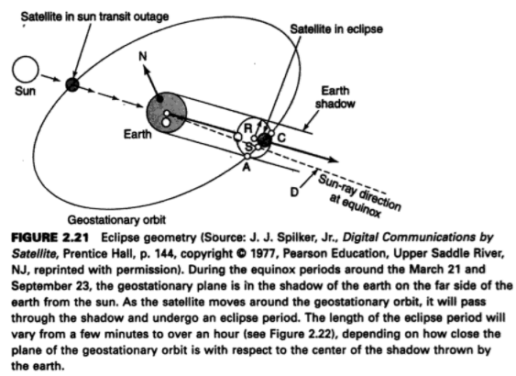

Slide 38
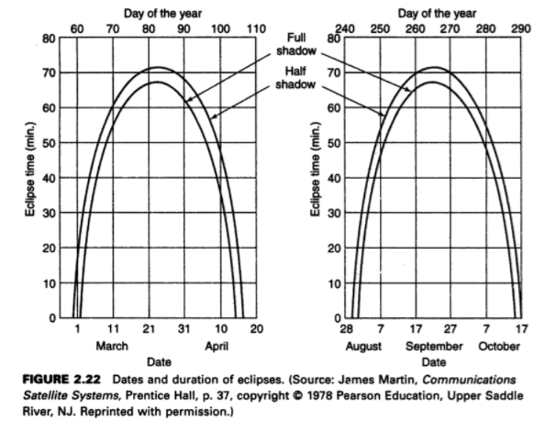

Slide 39
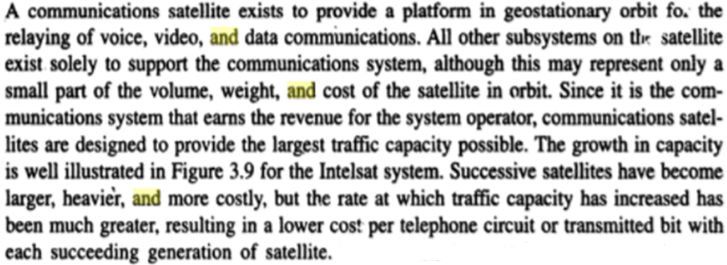
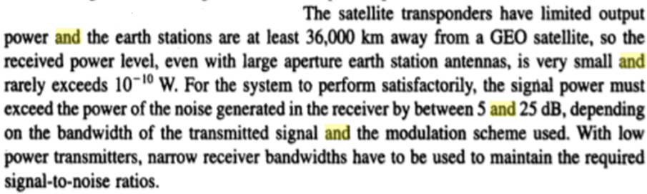
4. Communications subsystems

Slide 40
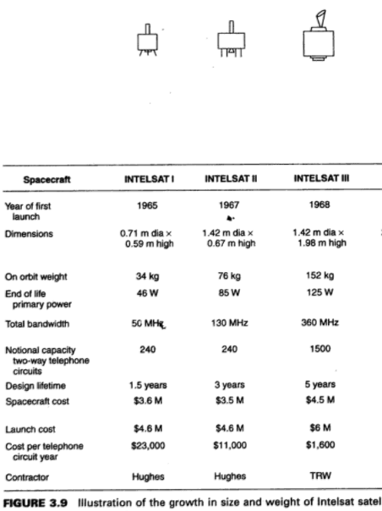

Slide 41
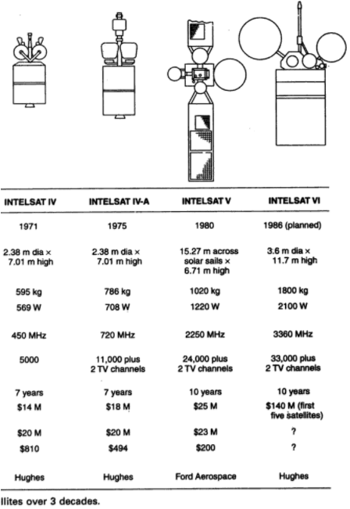

Slide 42
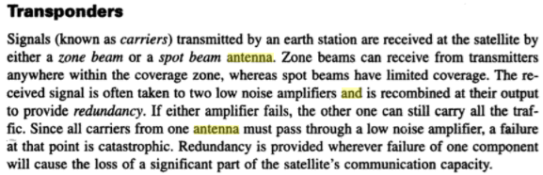
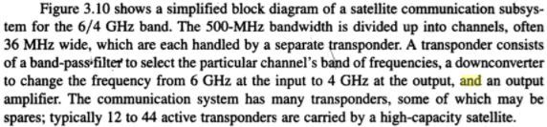

Slide 43
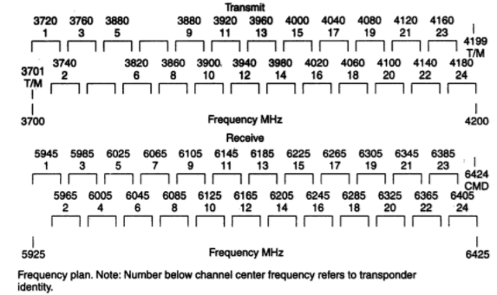

Slide 44
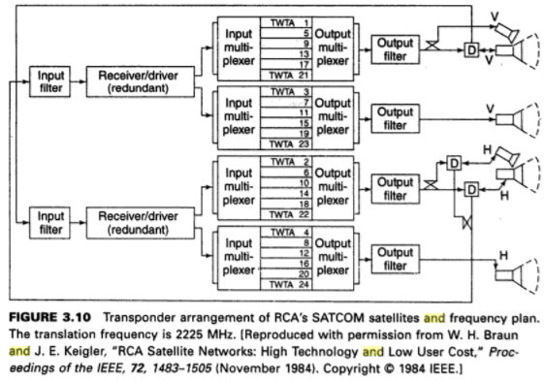

Slide 45
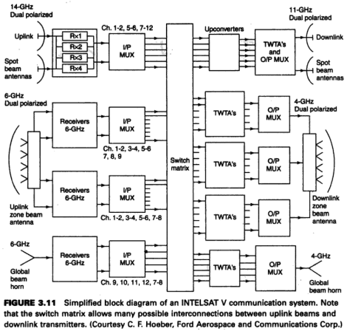

Slide 46
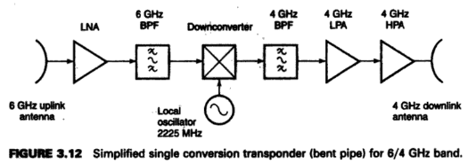

Slide 47
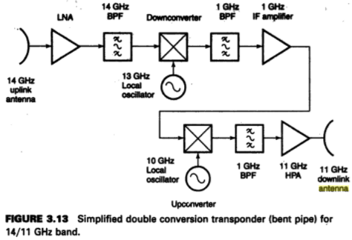

Slide 48
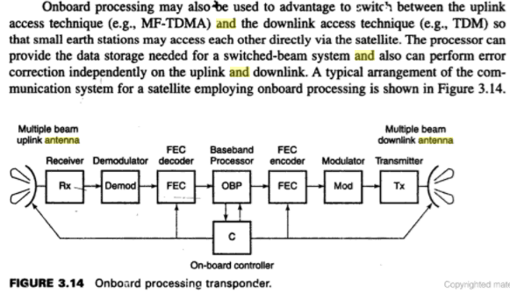

Slide 49
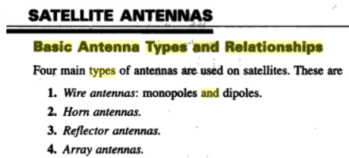
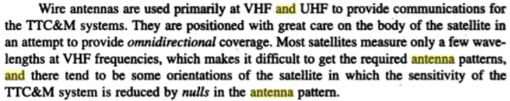
5. SATELLITE ANTENNAS

Slide 50

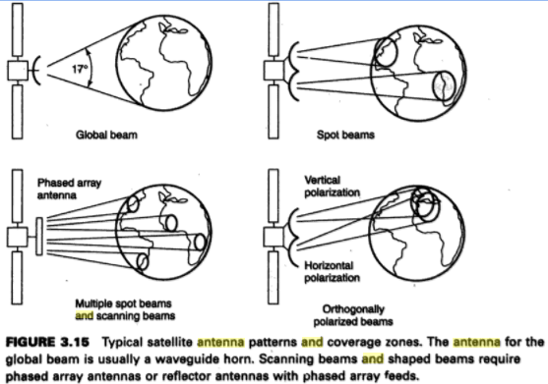

Slide 51
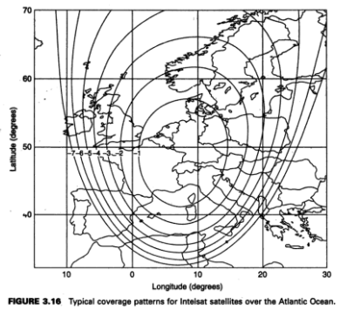

Slide 52
EQUIPMENT RELIABILITY AND SPACE QUALIFICATION

Slide 53
PURPOSE
NO POSSIBILIITY FOR REPAIRING COMPONENTS.
TO INCREASE THE LIFE TIME OF SATELLITE
HOSTILE ENVIRONMENT IN OUTER SPACE

Slide 54
METHODS
SPACE QUALIFICATION
Every part of the satellite to ensure that it has a long life expectancy in the orbit
REDUDANCY
The Components provides the link when the main link fails to provide the continued operation

Slide 55
SPACE QUALIFICATION
SELECTION AND SCREENING OF EVERY COMPONENT
PAST OPERATIONAL AND TEST EXPERIENCE
HIGH RELIABILITY UNDER OUTERSPACE
QUALITY CONTROL OR QUALITY ASSURANCE:
EACH COMPONENT IS TESTED INDIVIDUALLY TO ENSURE THAT IT MEETS ITS SPECIFICATIONS.

Slide 56
SPACE QUALIFICATION
PROTOTYPE MODELS:
MECHANICAL MODEL
THERMAL MODEL
SHAKE AND BAKE TEST
3. ELECTRICAL MODEL

Slide 57
RELIABILITY
REASONS:
1. What is the Probability is that subsystem will be still working
after a given time period?
2. To provide REDUNDANT When the probability of failure is
great .

Slide 58
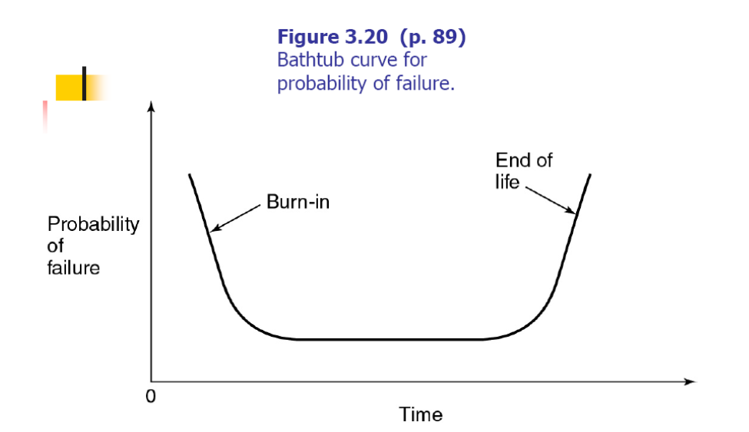
RELIABILITY-CURVE
RELIABILITY: It is the Mathematical concept to predict the future

Slide 59
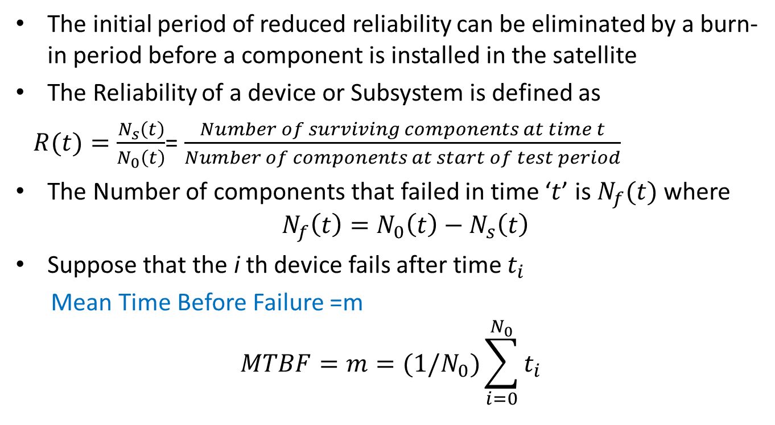
RELIABILITY
The initial period of reduced reliability can be eliminated by a burn-in period before a component is installed in the satellite
The Reliability of a device or Subsystem is defined as
$R(t)=\frac{N_{s}\left(t\right)}{N_{0}\left(t\right)}$= $\frac{Number of surviving components at time t}{Number of components at start of test period}$
The Number of components that failed in time ‘$t$’ is $N_{f}(t)$ where
$${ N}_{f}\left(t\right)=N_{0}\left(t\right)−N_{s}\left(t\right)$$
Suppose that the i th device fails after time $t_{i}$
Mean Time Before Failure =m
$$MTBF=m=(1/N_{0})\sum_{i=0}^{N_{0}}{t_{i}}$$

Slide 60
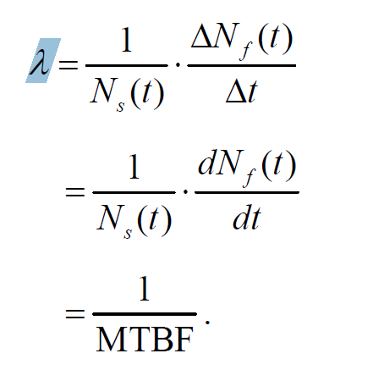

RELIABILITY
Assume that the average failure rate is constant and let it be defined by
$λ=\frac{Number of failures in a given time}{Number of surviving components}$

Slide 61
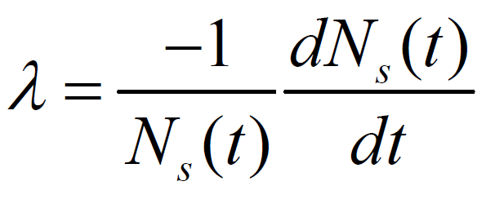
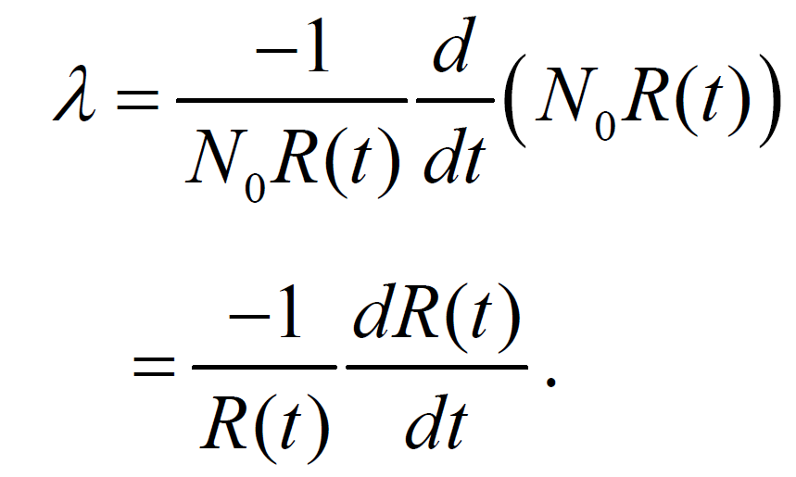
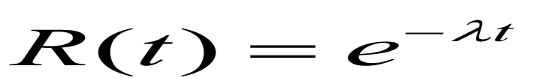
RELIABILITY
R = Ns /No

Slide 62
REDUDANCY
In a satellite, many devices, each with a different MTBF, are used, and failure of one device may cause catastrophic failure of a complete subsystem.
If redundant devices are incorporated, the subsystem can continue to function correctly.

Slide 63
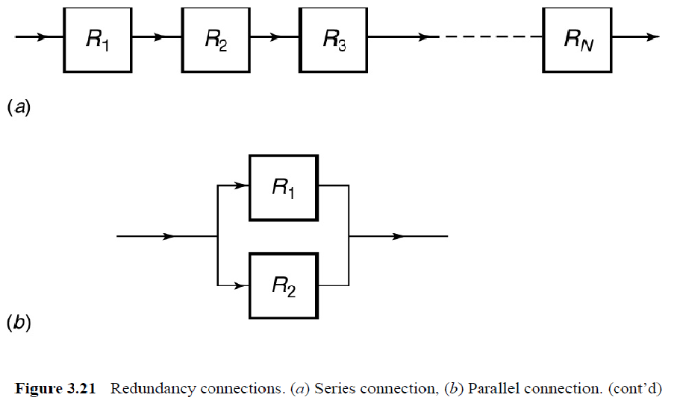
REDUDANCY
DIFFERENT SITUATIONS:

Slide 64
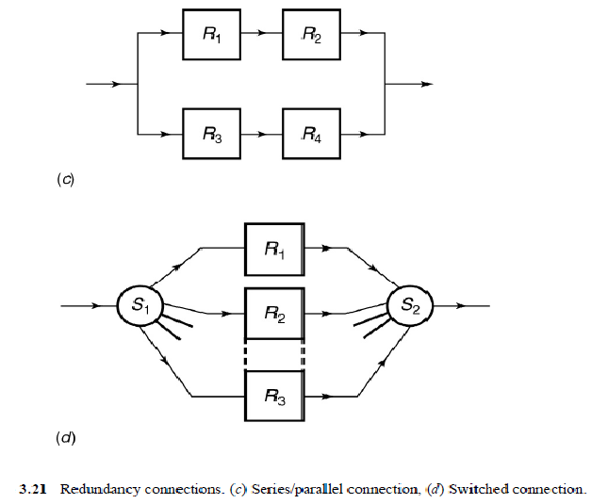
REDUDANCY

Slide 65
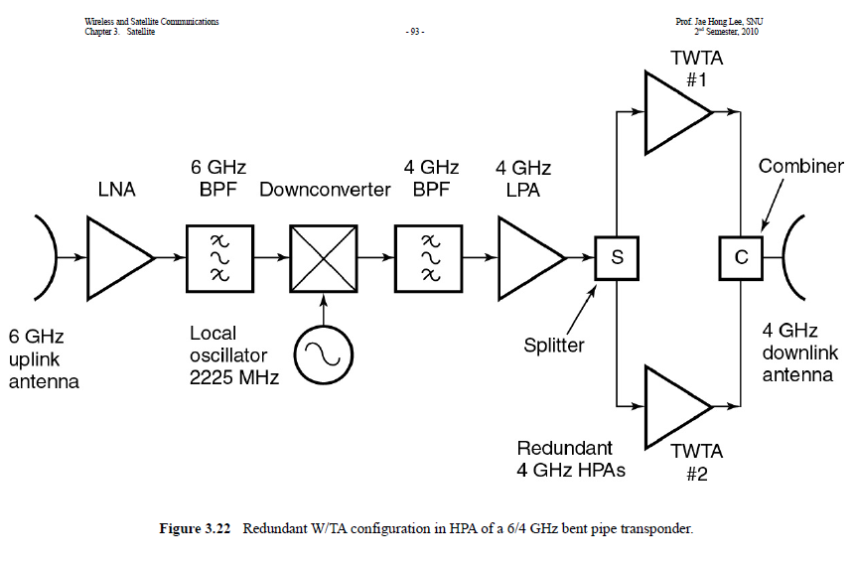
REDUDANCY

